Slide 1
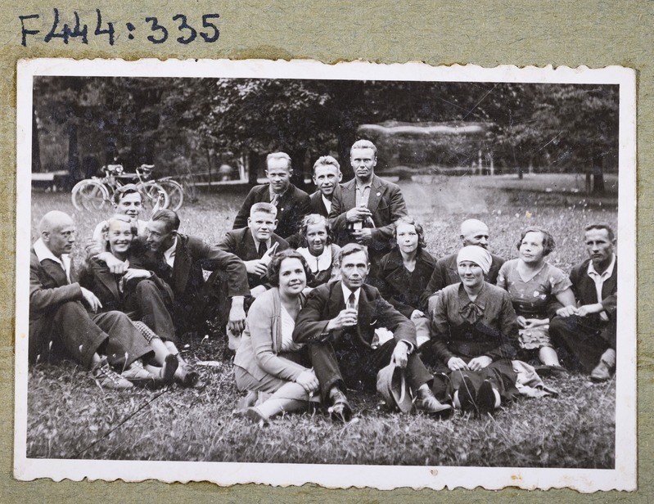
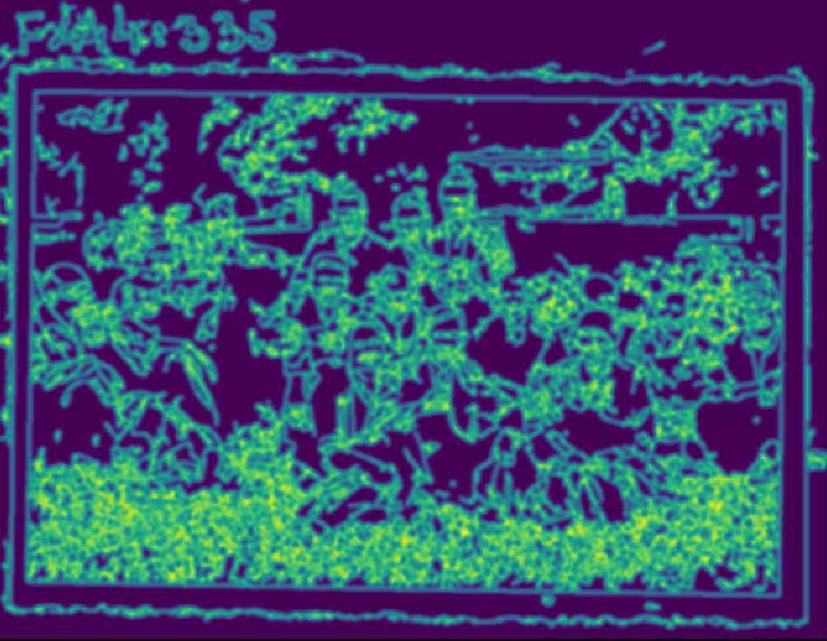

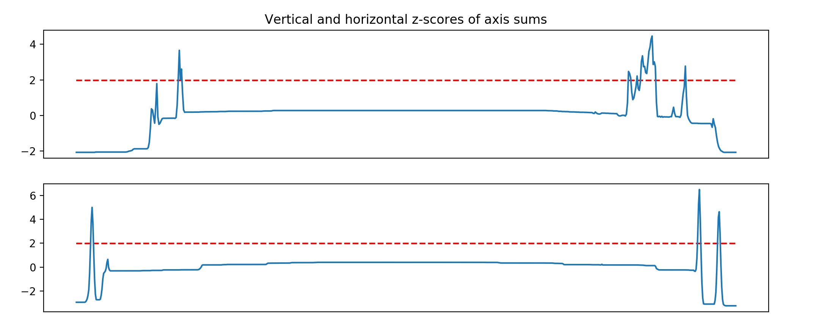
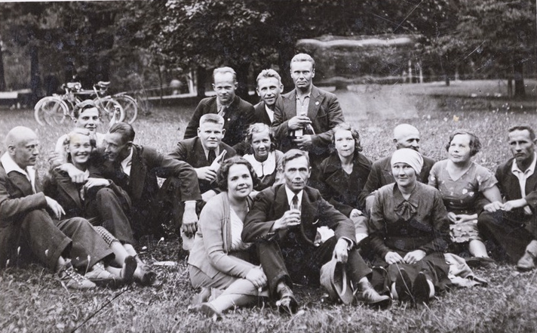

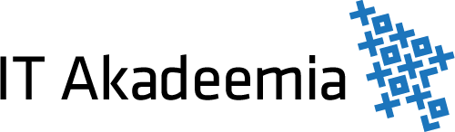
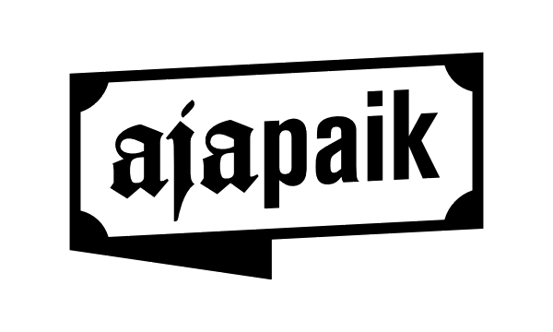
Cropping frames from images
Alvin Meltsov, Hain Zuppur
University of Tartu
2019
Introduction
Our project was done in cooperation with the historical pictures repository Ajapaik which in addition to accessing data from various national archive databases also expands on the available data by offering user-friendly website.
Our goal is to create an algorithm to automatically crop frames or excess from the images and only output the picture. The motivation behind this is to reduce the storage requirements of picture archives by eliminating not important space from the pictures and improving detecting duplicated photos from the dataset.
1
Data
Non-local means denoising
We get our data from ​ajapaik.ee and from Alvin Meltsov personal archive of Navi village. The pictures are usually portraits, group photos or pictures of buildings. Most of the images are black and white, but some are coloured. Main problem with the data is that many pictures are scans of photo albums or photos of those albums. The latter have often uneven lightning conditions.
We don’t do any manual processing to the images beforehand. As this algorithm only detects single pictures successfully, we selected 50 photos for our testing.
2
3
4
Methods
Image processing was done using Python libraries cv2, numpy, and scipy. The script crops the frames from images in following steps:
Applies non-local means denoising, which makes the picture blurred, but leaves stronger lines sharper.
Applies Canny edge detection with low thresholds to detect maximum amount of both horizontal and vertical edges with Sobel kernel.
Filter out lines that can be found only upwards or sideways or rotate until such lines are found for both directions.
Threshold the found images by calculating z-scores over both axes and selecting the nearest suitable (z > 1.98) coordinate from the center of given axis.
Rotate and crop the original image with found coordinates and degrees.
5
Results
From the 50 pictures we fed to the script 30 were processed, out of which 5 were cropped too eagerly. High failure rate and few false positives was our intent, as preserving the pictures is more important. The results could be improved by using CNN approach in future developments.
Project repository: github.com/hzuppur/Andmeteadus_projekt_ajapaik
Special thanks to Ajapaik and Vahur Puik for the idea!

